Slide 1

Fleet Management System

Slide 2
Problem Statement
While all education institutes use buses for transport, there is no automatic live tracking or a logging systems in place.
All the logging is manually processed by a security guard or a personnel placed at the entrance.
Data is stored in books and cannot be easily accessed or searched efficiently.
Human error is common in such places and can result in confusion.

Slide 3

Solution
Tracking the live location of the buses using a location device and sending it to the database.
Creating an easy-to-use interface for the stakeholders to view the current location of all the busses

Slide 4
Features
Live tracking of all busses.
Register Logs
Alert to stakeholders about their stoppage.
Notification about any route change/modification.
Modification of any bus routes.
SOS button (integrated into the Hardware device beside the driver).
Live speed measurements – Average, Max, live.

Slide 5
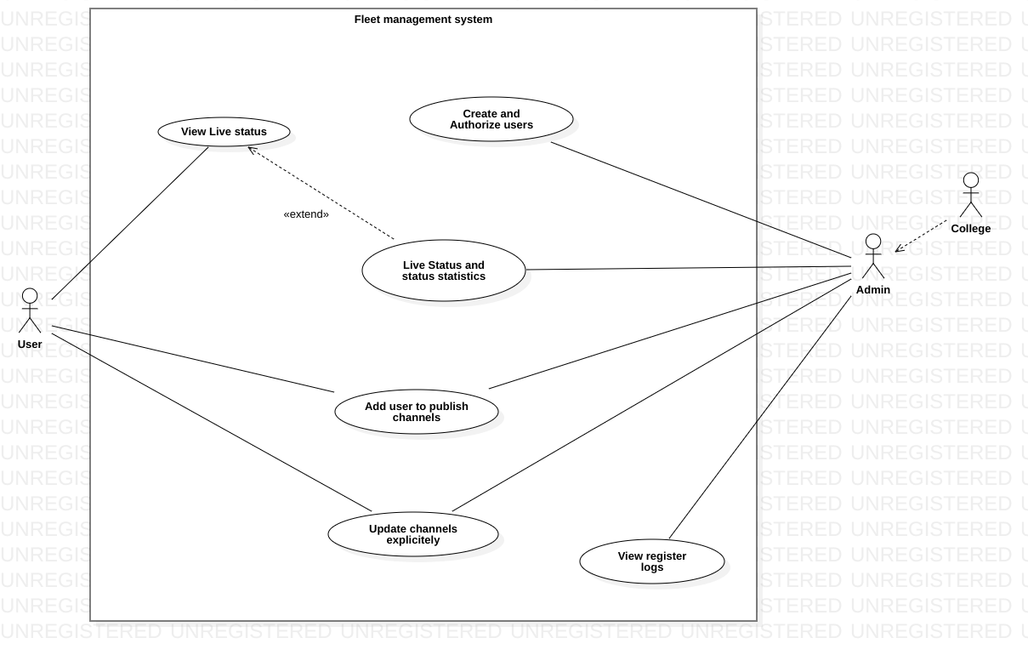
Use Case :

Slide 6
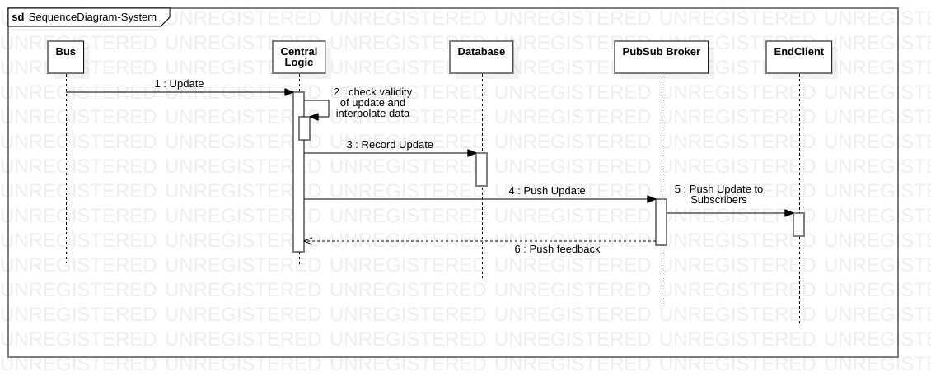
Sequence Flow :

Slide 7
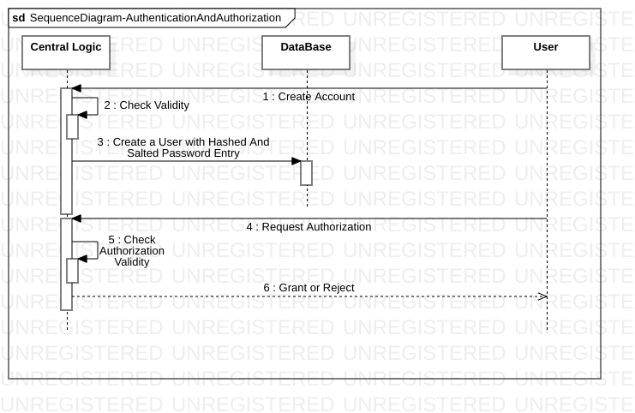
Sequence Flow :

Slide 8
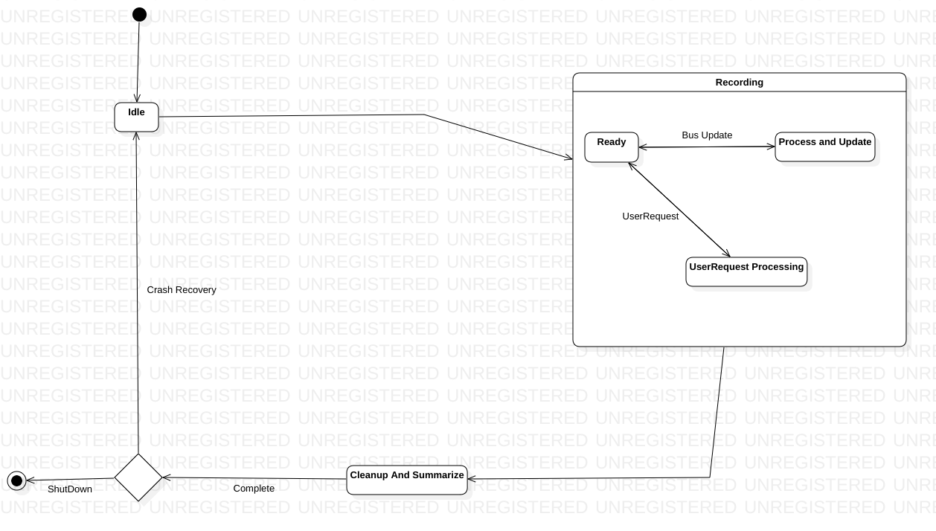
State Chart :

Slide 9
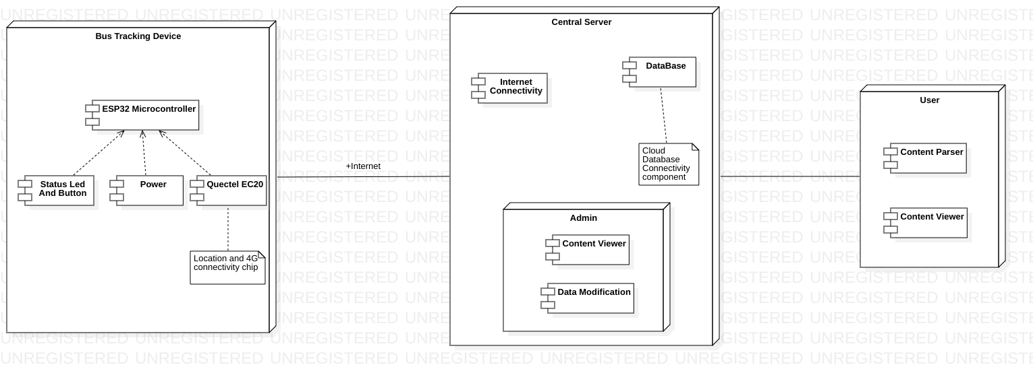
Deployment :

Slide 10
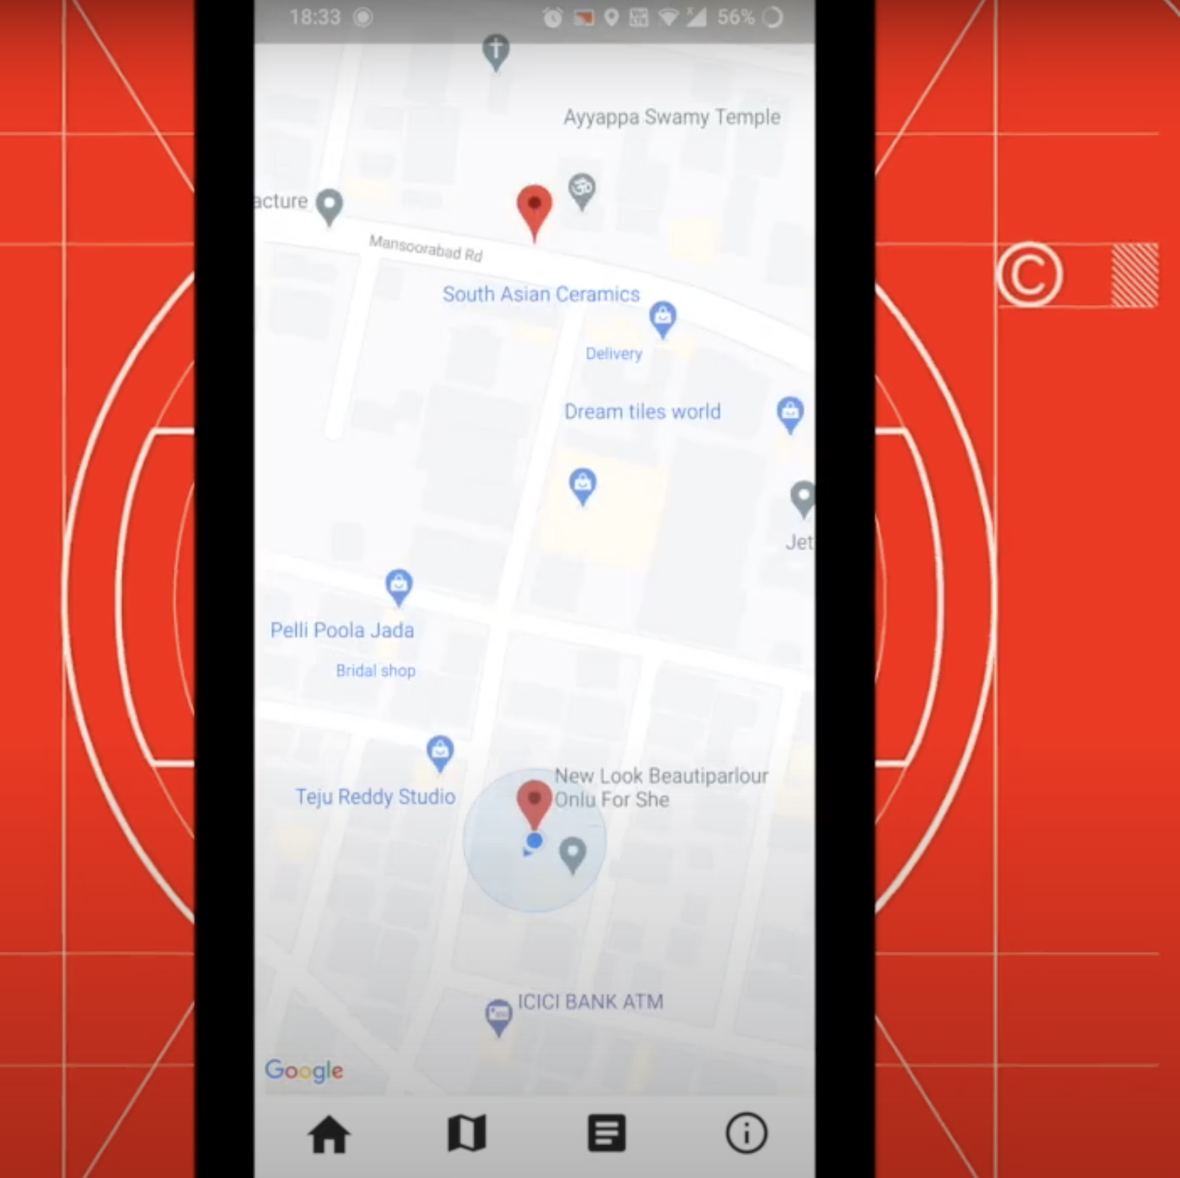
Software Implementation
Mobile App Interface
Connecting to Database
Uploading to Play store/Appstore
Database & server Price Estimation
Play store/Appstore Price Estimation

Slide 11
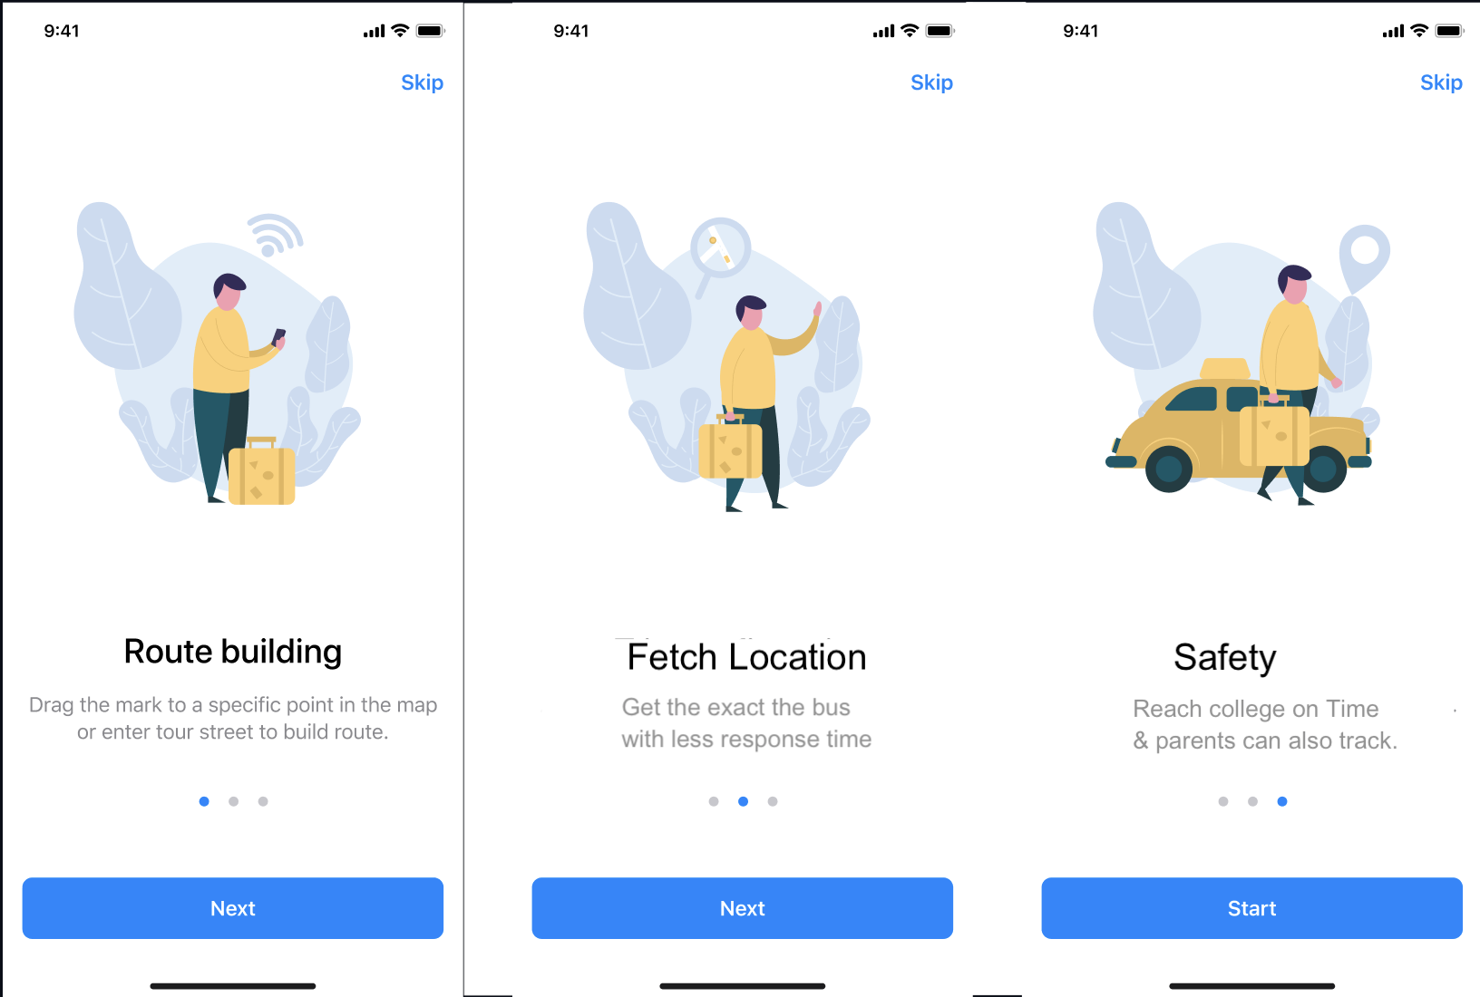
App Interface

Slide 12
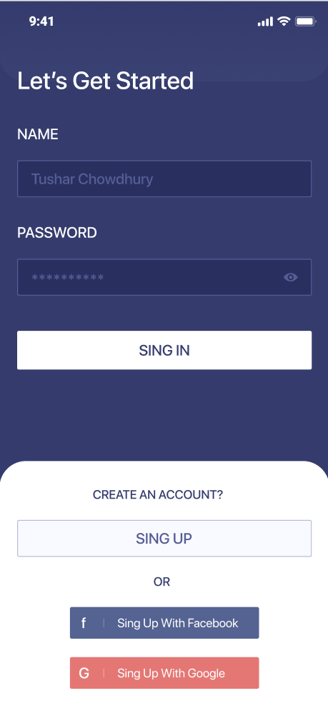
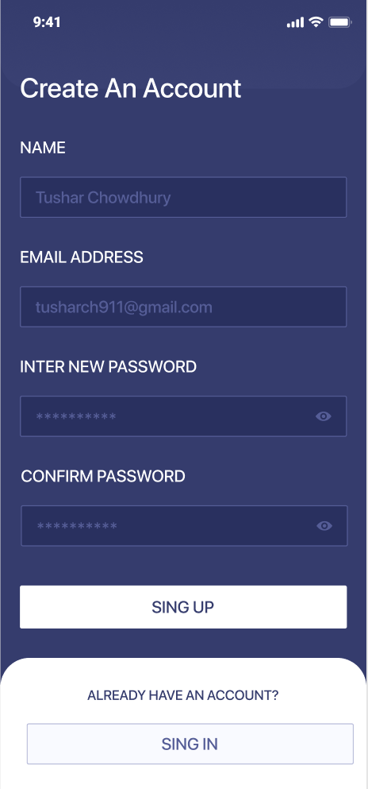
User Authentication
The user is authorized by the student e-mail authentication & password
The user should create the account only once.

Slide 13
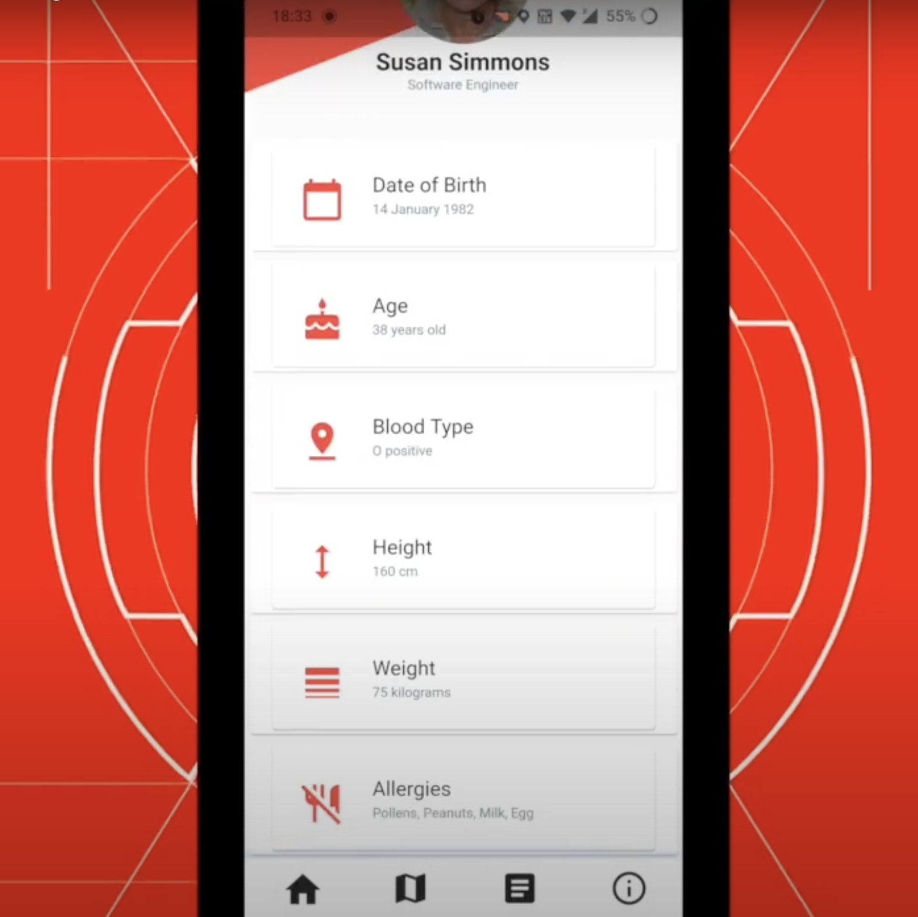
User Profile
We can display the user’s information.
We can profile an assistance and contact incase of any emergency &any queries.

Slide 14
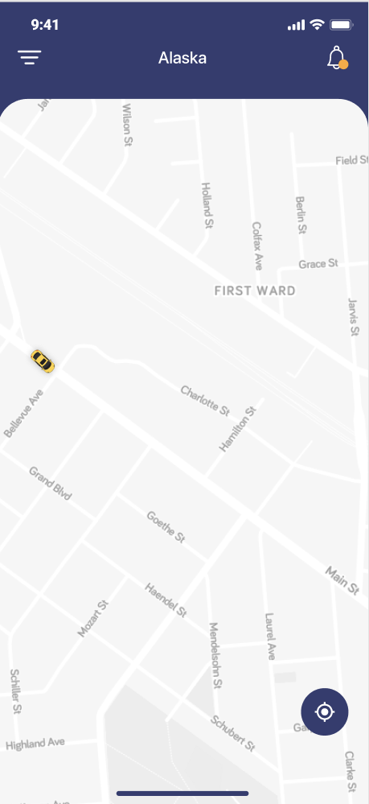
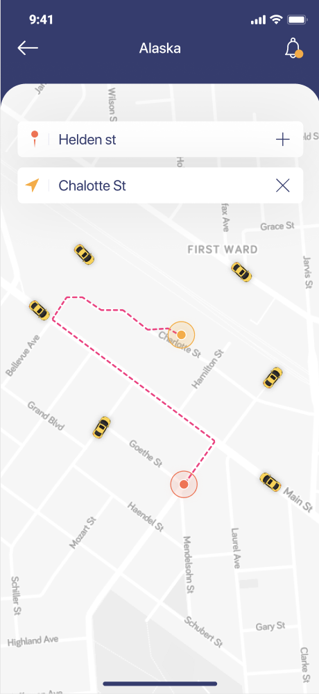
Map & Location
The user can choose the required Bus Number & can access the live Bus location.
The user could see the exact bus route and user's live location.
Upon selecting the bus no., user can see the estimated time to reach the boarding point.

Slide 15
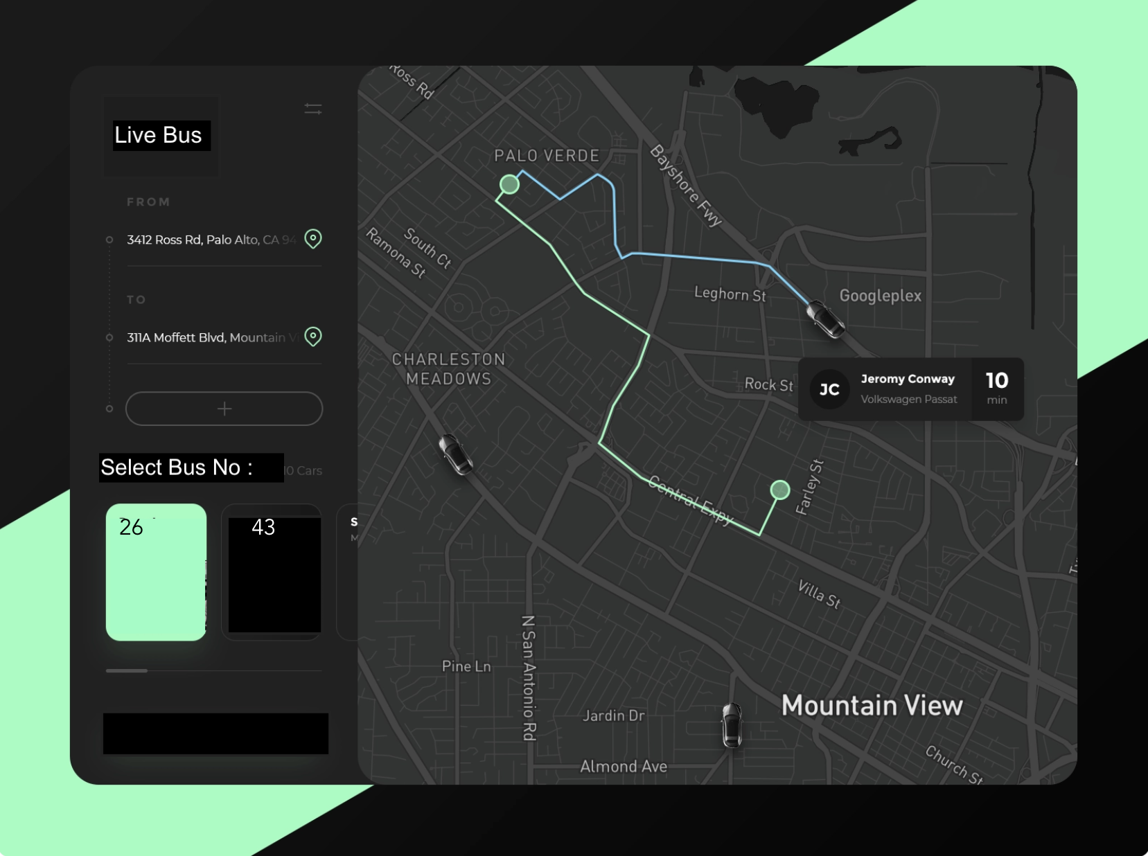
Dashboard
An interface for the college to view the system’s status
We can use a large screen device to track multiple buses in a single click

Slide 16



Tech Stack
React Native (Building the App UI)
Firebase (Hosting and Authentication)
React Redux (Maintaining the State)
Firebase FireStore (Database)
APIs Used
Google Maps API
Firebase Authentication API

Slide 17
Why React Native?
React Native is a cross platform open-source UI software framework created by Facebook.
An Application made with React Native can run as Web Application, Android Application and IOS Application, which means only a one time coded app can be used in any OS or device.
React Native is a JavaScript Framework.
Why Firebase?
Firebase is a platform developed by Google for creating mobile and web applications.
Firebase provides services in Hosting, Authentication and Database.
With help of Firebase, the App can be hosted, enable Authentication, connect with Database and use Google API’s fluently in a one place.

Slide 18

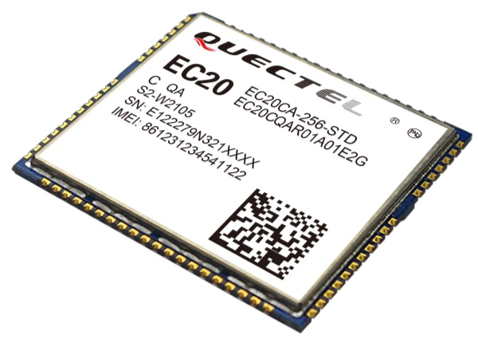
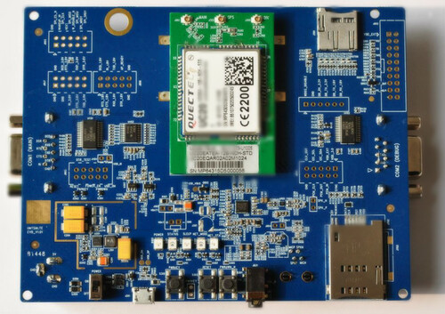
Hardware Implementation
Microcontroller- ESP 32
LTE+GPS Module EC20 Quectel

Slide 19
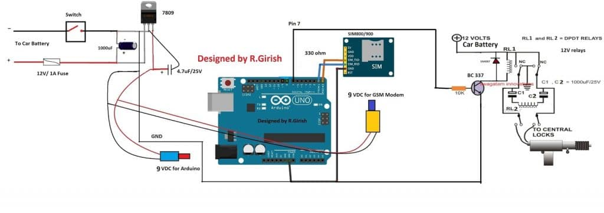
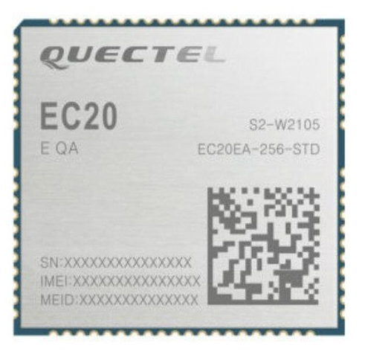
Working and Circuit Diagram
The module placed inside the bus will contain a microcontroller ,GSM module and a GPS module.
The latitude and longitude will be recorded by the GPS module and transmitted to the microcontroller in UART format.
The formatted data will be decoded by the microcontroller to stream of recordable data.
The LTE module will be responsible for communication with the database and will transmit the latest location of the bus to the data base server in real time.

Slide 20
Hardware Used :
MIMO technology meets demands for data rate and link reliability in modem wireless communication systems.
GNSS receiver is available for applications requiring fast and accurate fixes in any environment.
Simple migration from 3G to 4G with a flexible and scalable platform.
Bandwidth – 1.4/3/5/10/15/20 MHz
Temperature Range - -40°C ~ +85°C
Dimensions: 32.0mm x 29.0mm x 2.4mm
Supply Voltage: 3.3V~4.3V, 3.8V
Power Consumption
20 uA (Power off)
3mA (Normal Use)
QUECTEL EC20

Slide 21
Hardware Used :
This kit lets us interface with the EC20 chip and communicate with it
Wi-Fi & Ethernet TE-A Interface:FC20/AF20
UMTS&LTE TE-A Interface: UC20/UGxx/EC2x/EG9x/AG35/BG96
Power Supply: 4.5~5.5V, typical 5V, VBAT: 3.8V for J103
(U)SIM Interface: Support (U)SIM card: 3.0V and 1.8V
SD Interface: Support SD card
UART Interfaces: 2
Button and Switches: Power Switch (S201), PWRKEY (S302), RESET (S303), PWRDWN_N (S301), BT Function Switch (S901)
QUECTEL EC20 Development Board

Slide 22
Price Estimation
 | Hosting | Authentication | Database
Firebase (Spark Plan) Free Plan | Free (up to 10GB and data transfer of 360MB/day) | Phone Authentication: Free(10K/month) Other Authentication: Free | Simultaneous connections: only 100 1GB storage 10GB downloaded/month For free
Firebase (Blaze Plan) Paid Plan | $0.026/GB for Storage $0.15/GB for Data Transfer | Phone Authentication: $0.01/verification Other Authentication: Free | Simultaneous connections: Storage: $5/GB 1$/GB for GB downloaded
Play Store | Onetime Rs.1850Registration Fee
App Store | Onetime Rs.7500Registration Fee | 2.2 | 1.7
Total Price of Software Tools and Services: Rs. 15,000

Slide 23
Price Estimation
Estimated Cost for module in each bus :
Component | Module | Cost | Quantity | Total price
Microcontroller | ESP32 | Rs. 2500/- | 5 | Rs. 12500/-
Connectivity Module ( LTE + GPS) | Quectel EC20 chip | Rs. 4400/- | 5 | Rs. 22000/-
Development Kit | Quectel EC20-CE LTE Evaluation Board (EVB) Kit | Rs. 12000/- | 1 | Rs. 12000/-
 | Total |  |  | Rs. 46500/-

Slide 24
Price Estimation
Estimated Cost Miscellaneous Tools:
Custom PCB boards.
SIM cards (Paid out for 1 year of subscription).
Module Container and Casing.
Tools for assemble of modules.
Voltage converters
Total Price of Miscellaneous Tools : Rs. 28,000
TOTAL PROJECT ESTIMATE: Rs.15,000 + Rs. 46500 +Rs. 28,000 = Rs.89,500

Slide 25
Thank You.
Dr. Gaurav Sharma
- Asst. Prof., ECE
+91-9882146066
ergaurav209@yahoo.co.in
D Yashwanth Reddy
- CSE – 3rd Year ( 2019 - 2023)
S Abhinav
- ECE – 3rd Year ( 2019 - 2023)
Nikith Sai Veluvolu
- CSE – 3rd Year ( 2019 - 2023)

